Slide 1
Programming and Paradigms: Principles and Practices Lecture 1
Introduction to the course, Grammars
Dr. Pierpaolo Dondio,

Slide 2
Lecturer & Timetable
Dr. Pierpaolo Dondio
Office: 2nd Floor, CH214
Email: pierpaolo.dondio@tudublin.ie
Class:
Friday 10:00-13:00
Room CQ405
On campus
All recorded

Slide 3
Course content (in a nutshell)
Evaluate different Programming Language Paradigms
Discuss strength and limitations of different Paradigms
Choose the appropriate paradigm to solve a problem
Understanding the complexity and memory management issues
Apply refactoring to improve program structure

Slide 4
Course Philosophy
Practical things are important: demos, prototype, design
Written Exam – 50%
Assignment – 50%, divided in:
2 CA
In-class presentation
Lectures on webcourse (incrementally)
Attendance is good for you, me and the exam

Slide 5
Books
M.Gabbrielli, S. Martini (2010) Programming Languages: Principles and Paradigms, Springer
Pratt, Zelkowitz (2001) Programming Languages Design and Implementation, Prentice Hall
M. Fowler et al. Refactoring: Improving the Design of Existing Code , Addison Wesley 2010
Online resources on Prolog, Haskell.

Slide 6
Lectures Plan
Week | Lecture Content
1 | Introduction, Programming Languages, Grammar, Environment
2 | Environment / Memory Management
3 | Memory Management
4 | Logic Programming
5 | Logic Programming
6 | Logic Programming
7 | Revision Week
8 | Functional Programming
9 | Functional Programming
10 | Functional Programming
11 | OO Programming
12 | Refactoring
13 | Refactoring – In class presentation

Slide 7
What is a programming paradigm?
A style, but not only, a different approach, a different set of rules, a different ways of approaching and solving problems.
Procedural (and derivates such as OO).
Logic
Functional
Examples?

Slide 8
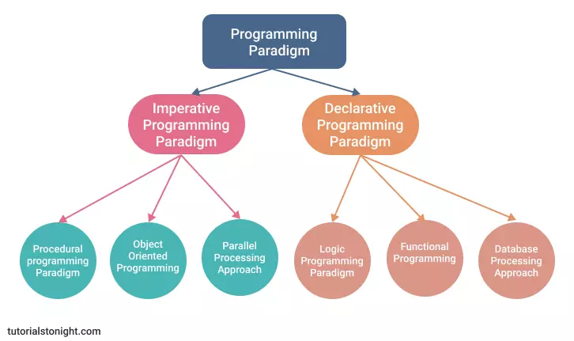
Programming Paradigms

Slide 9
Factorial of a Number
How would you do it?

Slide 10
Procedural way
function factorial(number)
{
if (number < 2) { return 1; }
else
{ return (number * factorial(number-1)); }
}
Recursive solution
It needs a stack-like memory (last in is the first out)
Compact and elegant solution

Slide 11
Procedural /2
public double factorial(int n)
{
double result = 1;
for(double i = 2; i<=n; ++i)
{ result *= i; }
return result;
}
Non-recursive (iterative).
Advantage: usually more efficient than a recursive solution, less memory management, but usually harder to express

Slide 12
Procedural /3
factorial1(n, accumulator)
{ if (n == 0) return accumulator;
return factorial1(n - 1, n * accumulator); }
factorial(n)
{ return factorial1(n, 1); }
This is a tail-recursive solution
In this kind of solution, the next recursive step the last thing executed by the function.
Advantage: we do not need to keep on the stack previous execution (as we do with standard recursion)

Slide 13
Functional
factorial 0 = 1
factorial n = n * factorial (n - 1)
Functional language (Haskell)
A program is a (math-like) function
No state and variables, just substitution of terms and evaluation of expression

Slide 14
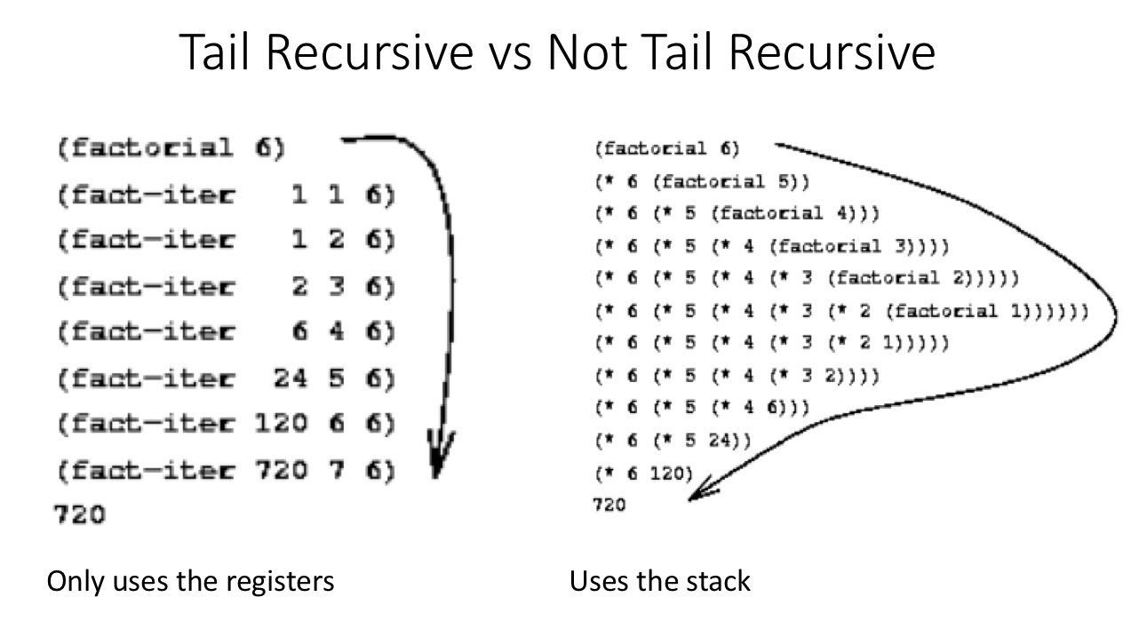
Tail vs. Not Tail Recursion

Slide 15
Prolog
fact1(0,Result) :- Result is 1.
fact1(N,Result) :- N > 0,
N1 is N-1,
fact1(N1,Result1),
Result is Result1*N.
Logic Programming language (Prolog)
A program is a set of rules and facts (the knowledge based)
Programs are executed by chaining matched rules using backtracking

Slide 16
A Logic Program example
/* At the Zoo */
elephant(george).
elephant(mary).
tiger(woods).
panda(ming_ming).
big_teeth(X) :- tiger(X)
big_teeth(X) :- elephant(X)
dangerous(X) :- big_teeth(X).

Slide 17
A Logic Program example
How do you execute a logic program?
You send a query to the program, the program returns an answer set with all the possible answer.
Example:
? elephant(george) [true]
? elephant(mark) [false]
? elephant(X) [X= george, X= mary]
? dangerous(X) [X=woods, X= george, X= mary]

Slide 18
Lecture 1 Describing a Programming Language
Grammars and Automata
Ambiguity
Semantic

Slide 19
Formal Translation Models
Grammars
Terminal and non terminal symbols
Grammar rules
BNF notation
Derivations, Parse trees and Ambiguity
Grammars for programming languages
Types of grammars
Regular expressions and Context-free grammars

Slide 20
Grammar Concepts
Syntax is concerned with the structure of programs.
The formal description of the syntax of a language is called grammar
Grammars consist of rewriting rules and may be used for both recognition and generation of sentences (statements).
Grammars are independent of the syntactic analysis.
Terminal and non-terminal symbols are used in grammar rules.
Terminals are used to represent things such as reserved words that cannot be replaced by other terms.
Non-terminals are used to represent categories of words and constituents which can be replaced by other terms.
The starting symbol S represents "sentence"
These symbols are used in grammar rules

Slide 21
Grammar Example
Rule Meaning
N → car N is the non-terminal symbol for "noun", “car" is a terminal "symbol"
D → the | a | an D is the non-terminal symbol for definite or indefinite articles.
NP → D N this rule says that a noun phrase NP may consist of an article followed by a noun

Slide 22
Backus-Naur Form
Grammars for programming languages use a special notation called BNF (Backus-Naur form).
The non-terminal symbols are enclosed in < >
Instead of → the symbol ::= is used
The vertical bar is used in the same way - meaning choice.
[ ] are used to represent optional constituents.

Slide 23
BNF Example
Grammars for programming languages use a special notation called BNF (Backus-Naur form).
The rule
<assignment statement> ::= <variable> = <arithmetic expression>
says that an assignment statement has
a variable name on its left-hand side
followed by the symbol "=",
followed by an arithmetic expression

Slide 24
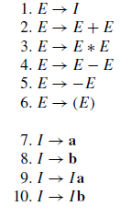
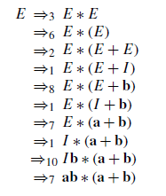
A more complex Grammar Example
derive
ab*(a+b)

Slide 25
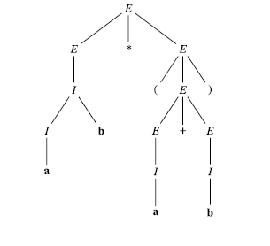
Derivation Trees
Root is the initial symbol
Children of each node express a production rule
Terminal nodes as leaves
Read left-right

Slide 26
4 types of Grammars for Programming Languages
Four types of grammars
Regular grammars: (Type 3 )
Rule format:
A → a
A → aB
Context-free grammars (Type 2)
Rule format:
A → any string consisting of terminals and non-terminals

Slide 27
Grammars for Programming Languages
Four types of grammars
Context-sensitive grammars (Type 1)
Rule format:
String1 → String2
|String1| ≤ |String2|, terminals and non-terminals
General (unrestricted) grammars (Type 0)
Rule format:
String1 → String2, no restrictions.

Slide 28
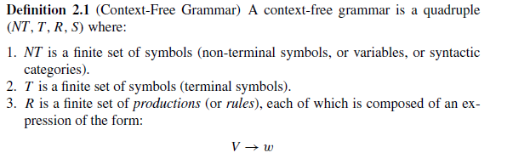
Context-Free Grammar (type 2)
V is a single NON-TERMINAL symbol
w is any string of terminal or non-terminal symbols

Slide 29
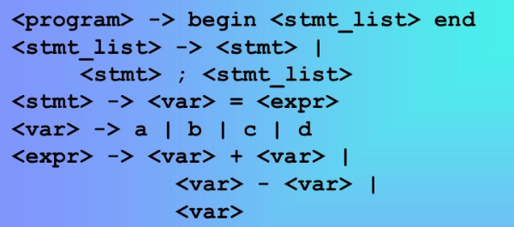
Grammar for a basic programming language
Simple programming language.
What kind of programs can be written?
begin
a = a;
b = b + c;
end
Begin, end and assignments…

Slide 30
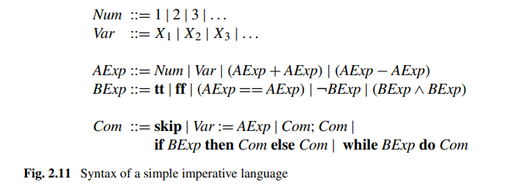
Grammar for a basic programming language /2
Example of a programme?

Slide 31
Regular Grammars and Regular Expressions (type 3 grammars)
Operations supported by regular grammars.
Operations on strings of symbols:
concatenation – appending two strings
Kleene star operation – any repetition of the string. e.g. a* can be a, or aa, or aaaaaaa, etc
+ meaning repetition but at least 1!
Regular expressions: are a form of representing regular grammars
Regular expressions on an alphabet ∑ consist of string concatenations combined with the symbols U (for union) and * (repetition), possibly using '(' and ')', along with the empty expression: Ø

Slide 32
Regular Expressions Example
Let ∑ = {0,1}.
Examples of regular expressions are:
(0 U 1)*, with possible values of any combination of 0s and 1s
0 U 1 with possible value 0 or 1
(0 U 1)1* with possible values 0, 01, 011, 0111,…, 1, 11, 111..
(0 U 1)*01 with possible values 01, 001, 0001,… 1101, 1001, (any strings that end in 01)

Slide 33
Regular and Context-Free Languages
Operations supported by regular grammars:
Regular languages are languages whose sentences can be described by a regular expression.
Regular expressions are used to describe identifiers in programming languages and arithmetic expressions.
Context-free grammars generate context-free languages.
They are used to describe programming languages.

Slide 34
Example 1 – What is this grammar computing?
T={0,1,2,3,4,5,6,7,8,9}
NT={N}
Start = N
N -> [0|..|9] N
N -> [0|..|9]
[0|..|9] means chose one of the non-terminal symbol

Slide 35
Example 2 – What is this grammar computing?
T={0,1,2,3,4,5,6,7,8,9}
NT={N,A}
Start = N
N -> [1|..|9]
N -> [1|..|9] A
A -> [0|..|9] A
A -> [0|..|9]

Slide 36
Example 3 – What is this grammar computing?
T={0,1,2,3,4,5,6,7,8,9,+}
NT={N,A}
Start = N
N -> [1|..|9] B
N -> [1|..|9] A
A -> [0|..|9] A
A -> [0|..|9] B
N -> N + N

Slide 37
Example 4 – What is this grammar computing?
T={0,1,2,3,4,5,6,7,8,9,+}
NT={N,A}
Start = N
N -> [1|..|9] B
N -> [1|..|9] A
A -> [0|..|9] A
A -> [0|..|9] B
B -> + N

Slide 38
Example 5
NT= {S}
T={(,)}
Start = S
Rules
S → SS
S → (S)
S → ( )
What is this grammar generating?

Slide 39
Finite-State Automata
Finite state Automata are a formalism to compute regular grammars
A (deterministic) finite automaton is a 5-tuple M = (Q, Σ, δ, q₀, F) where:
Q is the finite set of states
Σ is a finite set called alphabet
δ : Q × Σ → Q is the transition function
q₀ ∈ Q is the start state
F ⊆ Q is the set of accept states
and L(M) = the language of machine M = set of all strings machine M accepts

Slide 40
Finite-State Automata Example
M₁ = (Q, Σ, δ, q₀, F) where
Q = {q₁, q₂, q₃, q₄}
Σ = {0,1}
δ : Q × Σ → Q is the transition function
q₁ ∈ Q is start state
F = {q₄} ⊆ Q accept state
0,1
1
0
0
0
1
q₁
q₂
q₃
q₄
1
δ | 0 | 1
q₁ | q₂ | q₁
q₂ | q₃ | q₁
q₃ | q₃ | q₄
q₄ | q₄ | q₄

Slide 41
Non-Deterministic Finite-State Automata
A non-deterministic finite automaton is a 5-tuple M = (Q, Σ, δ, q₀, F) where:
Q is the finite set of states
Σ is a finite set called alphabet
δ : Q × Σ _{є} → Q is the transition function, where Σ _{є} = Σ U {є}
(є – referred to as epsilon - is the empty string)
q₀ ∈ Q is the start state
F ⊆ Q is the set of accept states
and L(M) = the language of machine M = set of all strings machine M accepts.
NFAs differ from deterministic automata in that there may be more than one possible transition between a pair of states given a particular input.
Note: NFAs can be defined that don’t accept epsilon as input.
NFAs that do accept epsilon are referred to as NFAs with є-moves.

Slide 42
PushDown Automata
More expressive than FSA
Can compute any context-free grammar
They use a stack as memory (therefore they can count and compute recursive function)
Like FSA + a stack memory

Slide 43
PDA - definition
A PDA can be formally described as a 7-tuple (Q, ∑, S, δ, q₀, I, F):
Q is the finite number of states
∑ is input alphabet
S is stack symbols
δ is the transition function: Q × (∑ ∪ {ε}) × S × Q × S*
q₀ is the initial state (q₀ ∈ Q)
I is the initial stack top symbol (I ∈ S)
F is a set of accepting states (F ∈ Q)

Slide 44
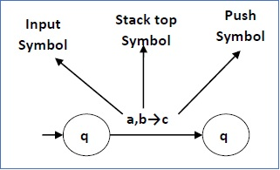
PDA – transition function
1
2
This means at state q₁, if we encounter an input string ‘a’ and top symbol of the stack is ‘b’, then we pop ‘b’, push ‘c’ on top of the stack and move to state q₂.
A PDA may or may not read an input symbol, but it has to read the top of the stack in every transition.

Slide 45
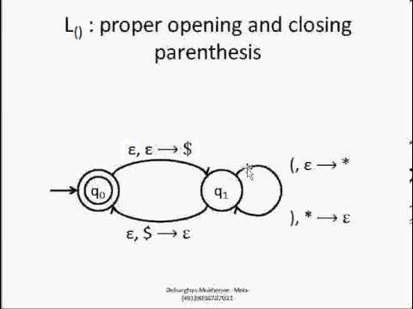
Balanced Parenthesis
The “epsilon” is the symbol for “empty symbol”, it means that no symbol is read.
$ = first symbol on the stack
A string is accepted if we are on a terminal state and the stack is empty

Slide 46
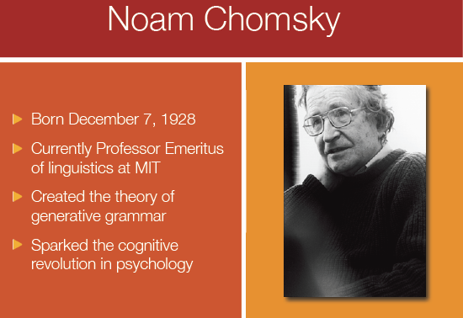
Chomsky Hierarchy

Slide 47
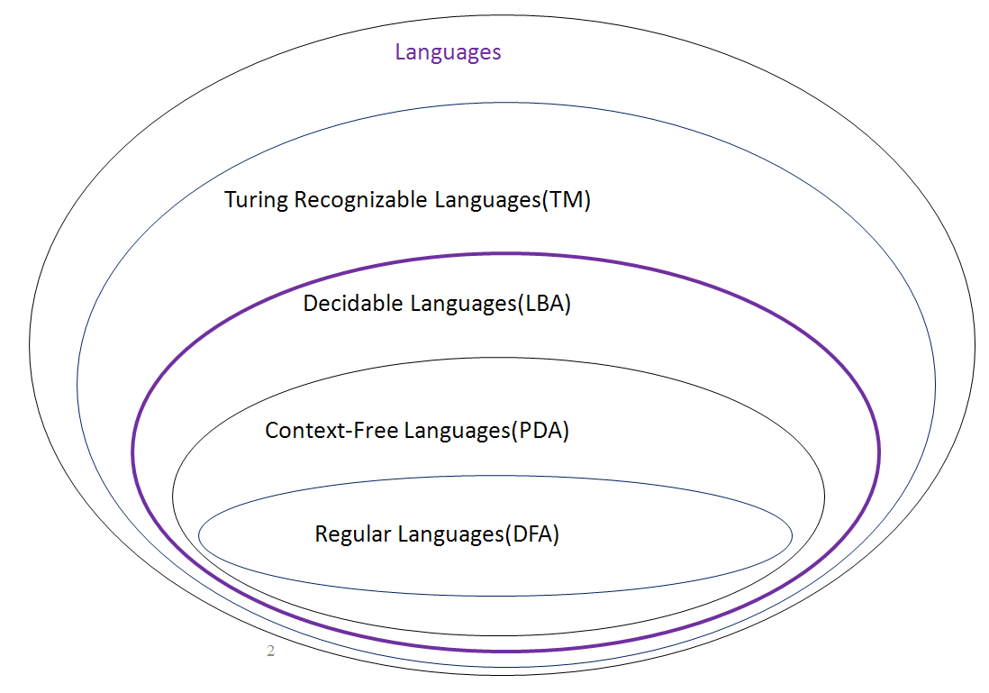
Chomsky Hierarchy

Slide 48
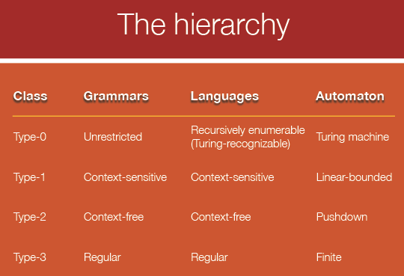
Chomsky Hierarchy

Slide 49
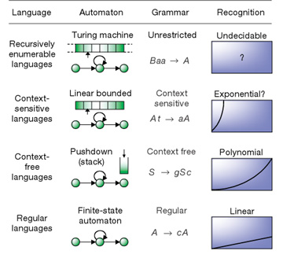
Computational Power of Automata

Slide 50
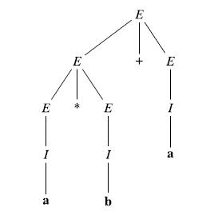
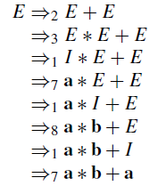
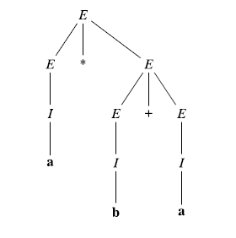
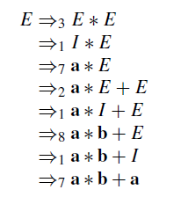
More than one tree...

Slide 51
Ambiguity
We may have the problem that a set of grammar rules can generate two possible parse trees for one and the same sequence of terminal symbols.
Example:
Rule1: If_statement → if Exp then S
Rule2: If_statement → if Exp then S else S
Data to be parsed:
if a < b then if c < y then write(yes) else write(no);
First interpretation using Rule1:
If a < b then { if c < y then write(yes) else write(no); }
Second interpretation using Rule2:
If a < b then { if c < y then write(yes) } else write(no);

Slide 52
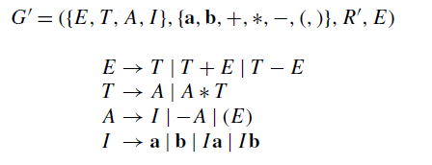
Good news: unambiguous is always possible
Valid precedence rule is implemented
At a cost of complexity and more non-terminal symbols

